Slide 1
Micro Plasma Welding systems
arcraftplasma@gmail.com

Slide 2
Plasma the fourth state of matter
Plasma in the context of welding is ionised air/gas acting as a conductor of electricity .
This ionised air/gas is highly heated and is the form of a columnar highly focused beam as opposed to the conical TIG arc .
At lower currents as applicable to thin sheet welding or sintered mesh welding the Plasma arc is focused and carrying a much higher heat content enabling welding unlike TIG where much higher currents will be used resulting in a thicker weld or burning / distortion of parent metal .

Slide 3
Micro Plasma welding system
The complete system consist of
Power source .
Micro plasma welding torch with cables.
Water chiller cum recirculator.
Automation can be provided wherever required.

Slide 4
The Power source
Power source is inverter based with a current output of 0.5 to 50 amps .This can also be changed to 1 to 100 amps if required. It has inbuilt pilot arc system for initiating the arc . Continuos pilot arc can be provided for welding mesh or similar jobs .Flowmeters for adjusting plasma gas and shielding gas are provided. All parameters like up slope , down slope , pulsing of current can be set . Digital display is provided for current and voltage settings. Safety measures in case of failure of gas / water are inbuilt.

Slide 5
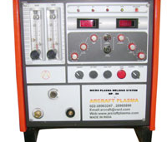
Power source

Slide 6
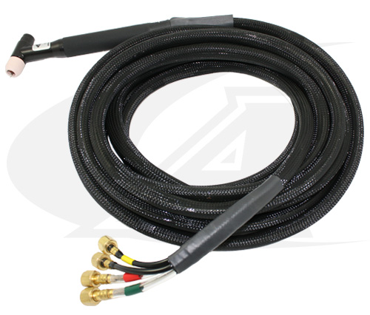
Welding Torch
The micro plasma welding torch is a highly precise and lightweight equipment for easy handling. It is provided with 4 meter cables.

Slide 7
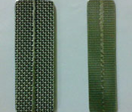
Sample welds

Slide 8
Automation
The plasma process is easily automated and can give very good results .
Automation eliminates the need for highly skilled welders , lowers worker fatigue , increases productivity and gives repeatable quality welds .
Welding positioners , linear welding automation , various devices as per job requirement are designed and provided by Arcraft Plasma .

Slide 9
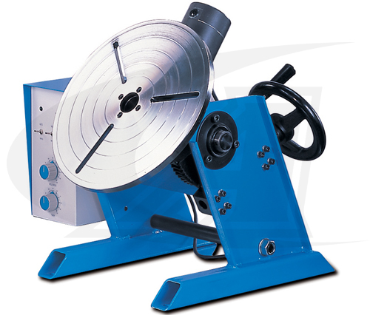
Welding Positioner

Slide 10
Contact us
For all your welding and automation requirements
arcraftplasma@gmail.com
0091 22 28963247, 28965745 , 28965890
Fax 0091 22 28966418
Arcraft Plasma Equipments ( I ) Pvt Ltd
124, Diamond Industrial Estate ,
Ketkipada , Dahisar ( East )
Mumbai 400068

